Slide 1





SLEEP TRACKER
PRESENTED BY
R.KARTHI - 815422243009
S.SANJAY – 815422243022
N.SANJAY - 815422243021
P.RAHUL - 815422243016 R.DHEENADHAYALAN - 815422243005

Slide 2


context
1
INTRODUCTION
2
SLEEP TRACKING
IMPORTANCE
3
5
4
ADVANTAGES
5
DISADVANTAGES

Slide 3








INTRODUCTION
Sleep tracking can be
used to track
sleep abnormalities and
the sleep quality
of people and help
healthcare providers
diagnose their
patients with sleep disorders.

Slide 4


SLEEP TRACKING
Trackers can detect
interrupted
sleep, letting
you know when
you're tossing
and turning or waking
during the night.

Slide 5
IMPORTANCE
help you learn more
about when you wake up
and fall asleep,
how and when you
accumulate sleep debt,
and can provide tools to
help diagnose
a potential sleep disorder.

Slide 6
IMPORTANCE
help you learn more
about when you wake up
and fall asleep,
how and when you
accumulate sleep debt,
and can provide tools to
help diagnose
a potential sleep disorder.

Slide 7
IMPORTANCE
help you learn more
about when you wake up
and fall asleep,
how and when you
accumulate sleep debt,
and can provide tools to
help diagnose
a potential sleep disorder.

Slide 8
ISSUSE
IT SHOW SOME
MIS LEADING
INFORMATIONS
SOME TIMES
BUT IT ONLY
78% SCCUSRCY.

Slide 9
EXPIRY
IT DOES NOT
EXPIRY ITS LIFE
TIME WORK
IT TAKE ONLY
MALFUNCTION.

Slide 10
IMPORTANCE
help you learn more
about when you wake up
and fall asleep,
how and when you
accumulate sleep debt,
and can provide tools to
help diagnose
a potential sleep disorder.

Slide 11
ADVANTAGES
Sleep tracking improves
infant sleep problems,
with about 1 in 4 to
1 in 10 benefiting
compared with
no sleep training,

Slide 12
TYPES
CHILD TRACKER
BABY TRACKER
OLD AGE PEOPLE TRACKER

Slide 13
ADVANTAGES
IT USE ONLY
20K CHARGE IN THE APPLICATION
IT WOR MORE
THAN 10 HOURS

Slide 14
CONCULSION
THERE FOR THIS ABOUT THE SLEEP TRACKER

Slide 15
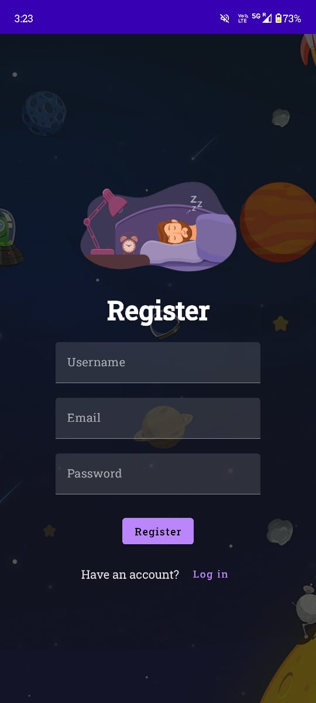

Slide 16


Slide 17
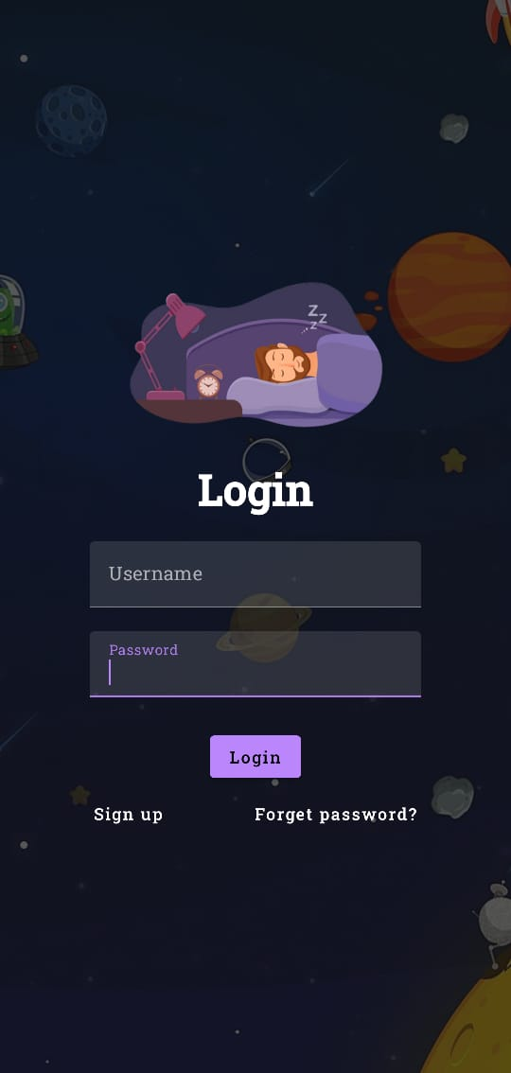

Slide 18
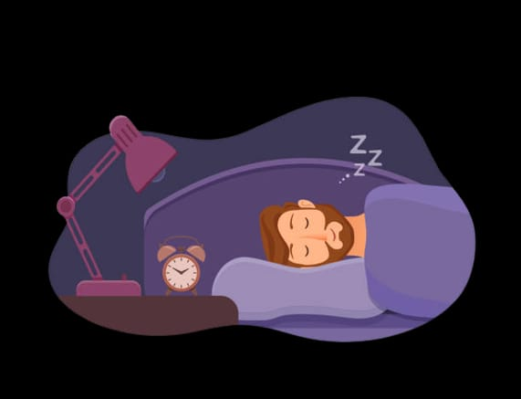

Slide 19


Slide 20


